Slide 1

Installation
Installing Visual Studio Code and the extensions

Slide 2

Installation
https://code.visualstudio.com/download
Notes:
For code typing.

Slide 3

Installing Extension
Notes:
For displaying of webpages on chosen browser.

Slide 4

Online IDE
https://codepen.io/

Slide 5
HTML
What is this language?

Slide 6
What is HTML?
Hyper Text Markup Language.
Standard markup language for creating Web pages.
Describes the structure of a Web page.
Consists of a series of elements that tells the browser how to display the content.

Slide 7
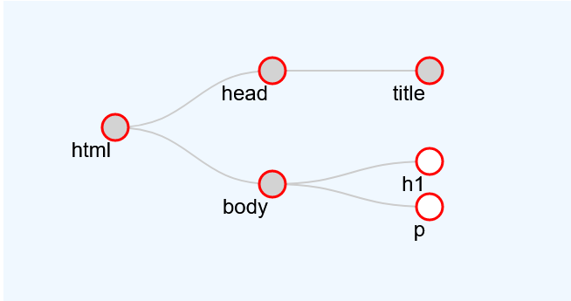
Tree Structure
Notes:
Html – “parent”
Head and body – “siblings”
Head – “child”, etc

Slide 8
Typical Syntax
<!DOCTYPE html> <html> <head> <title>Page Title</title> </head> <body> <h1>This is a Heading</h1> <p>This is a paragraph.</p> </body> </html>

Slide 9
What these mean?
The <!DOCTYPE html> declaration defines that this document is an HTML5 document
The <html> element is the root element of an HTML page
The <head> element contains meta information about the HTML page
The <title> element specifies a title for the HTML page (which is shown in the browser's title bar or in the page's tab)
The <body> element defines the document's body, and is a container for all the visible contents, such as headings, paragraphs, images, hyperlinks, tables, lists, etc.
The <h1> element defines a large heading
The <p> element defines a paragraph
Notes:
There is more, which we will talk about later

Slide 10
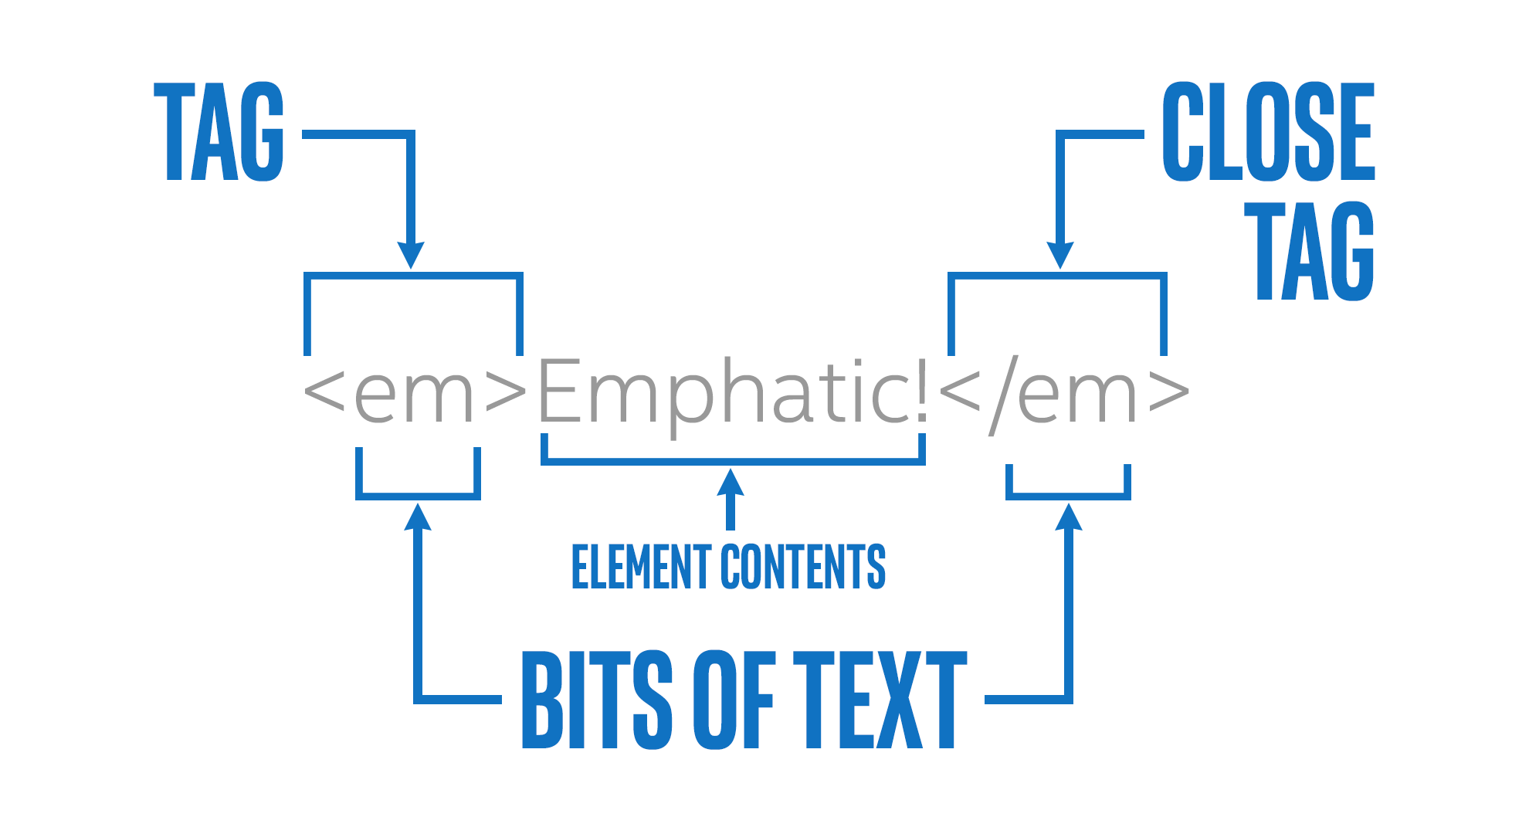
What is an Element?
An HTML element is defined by a start tag, some content, and an end tag:

Slide 11
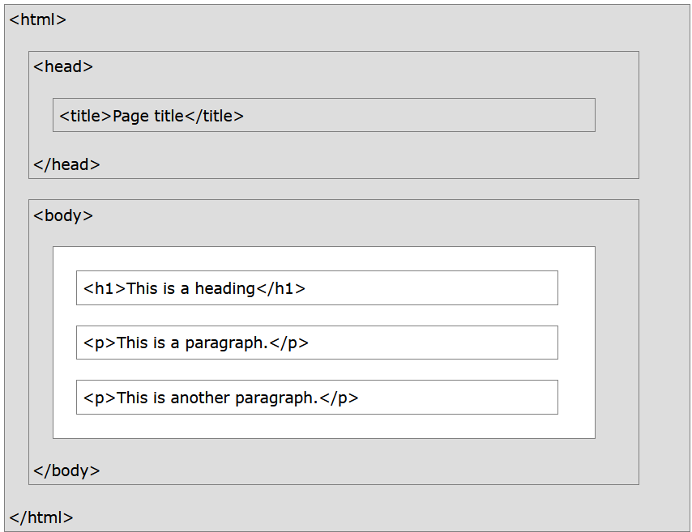
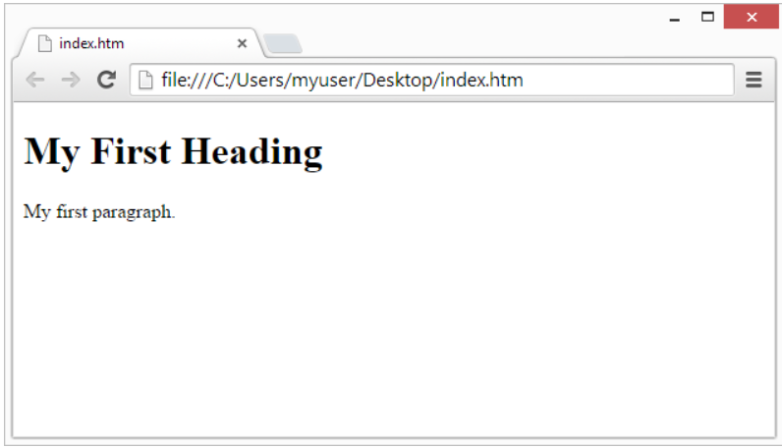
Web browsers
The purpose of a web browser (Chrome, Edge, Firefox, Safari) is to read HTML documents and display them correctly.

Slide 12
Task 1
Write a Hello World HTML script

